Slide 1


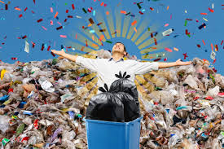
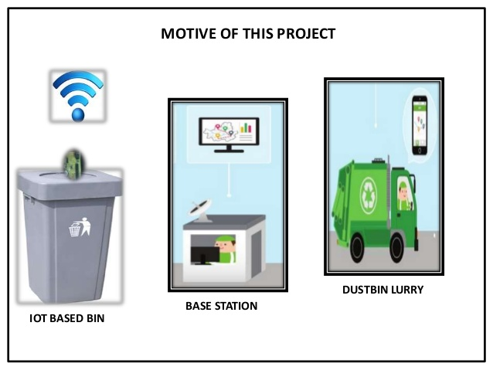
Garbage collection Paltform SatLiNeh
by :
Fatima Torabi
And
Sohail Sabzevari
Summer 2022

Slide 2
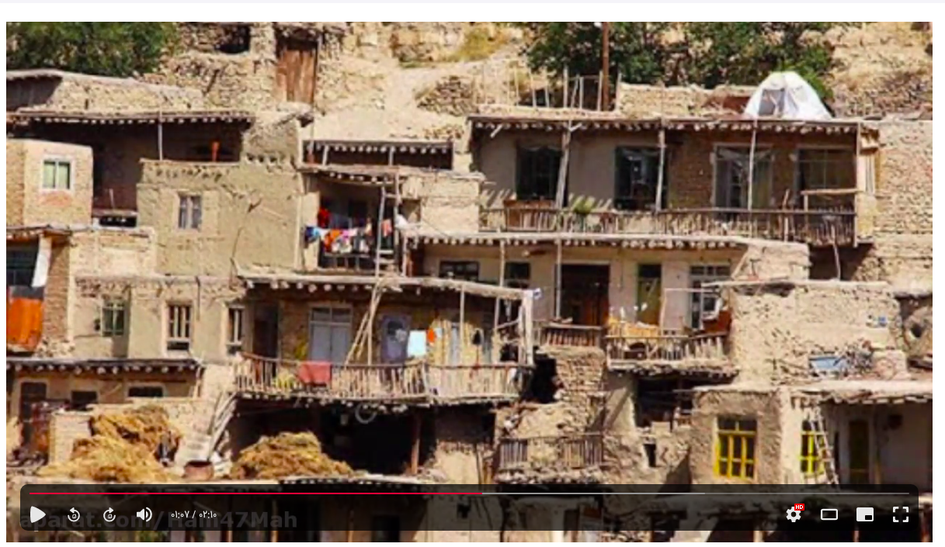
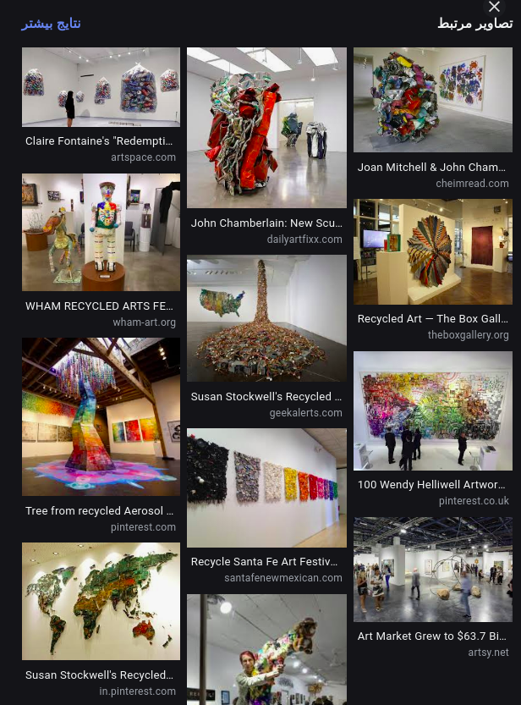

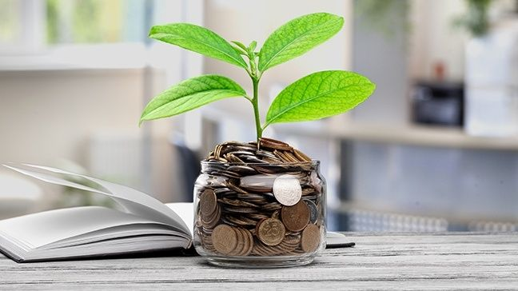
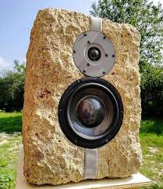
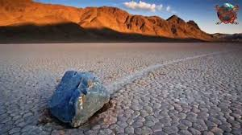
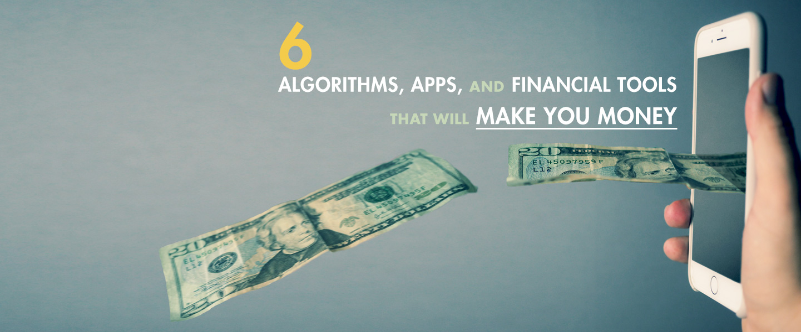
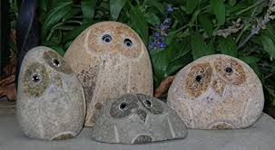
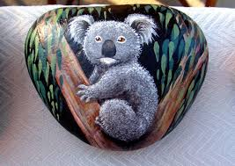
The Story of Satlineh
LET'S GET UP! — Live the life, Have Fun & Feel Good
Everything Starts as a Dream, but Requires Action
قطره را بشویم، دریا را در نوسان آییم.
ما وزش صخره ایم ، ما صخره وزنده ایم.

Slide 3

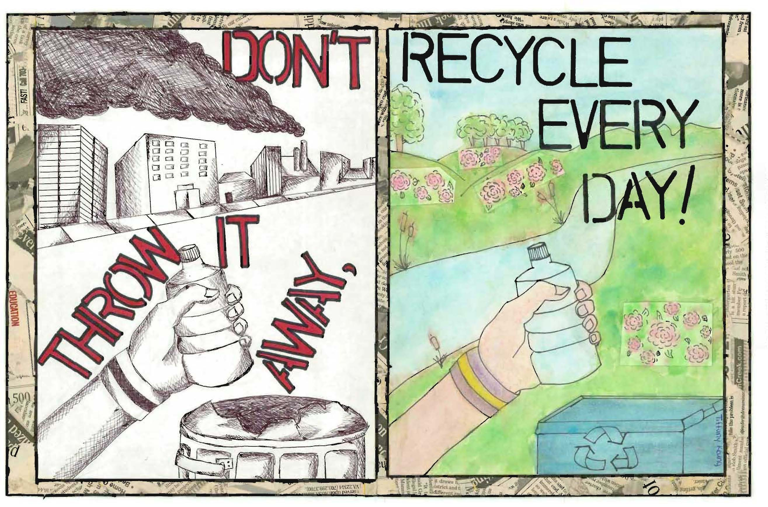
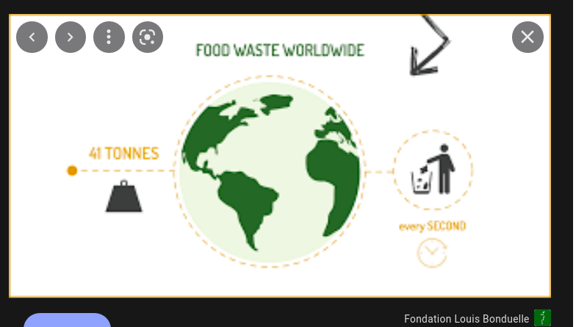
difficulties
Poor waste management contributes to climate change and air pollution, and directly affects many ecosystems and species.
Rapid economic growth and Waste Economic Problems:
UN report:The Economic Loss of world's food wasted annually is around The $750 billion or %33 of its value (link).
- توانمند سازی اقتصادی و فراهم سازی دسترسی نیروی کار درگیر در بازیافت زباله به تکنولوژی های جدید

Slide 4


Digital technologies will deliver more efficient waste management.
Using the Game Theory, Ocean Blue Strategy and Crpytocureny Stock ,for Incoming in the global market of waste (1.6 Trillion$/y) and Encouraging the Community to do more Recycling:
The Solutions

Slide 5
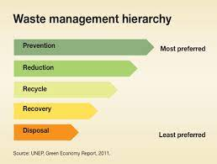
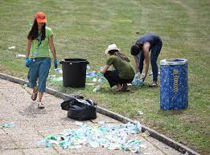
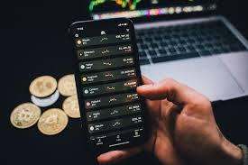
Improving quality, speed and reducing waste recycling costs for customers and buyers of recycled materials
Increasing capital and a sense of cooperation among customers (credit within the Cryptocurrency Stock program and creating an internet-based interaction platform)
Value proposition And the product

Slide 6

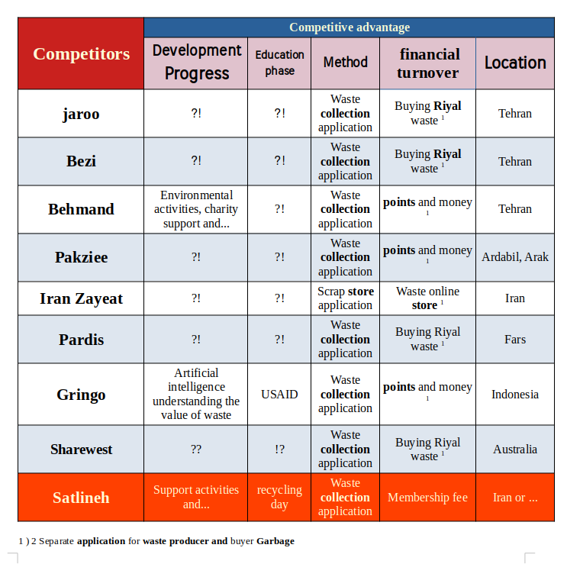
Competitive advantages compared to the other samples
The geographical scope of coverage (Smart City and ...)
Incentive algorithms (financial, etc.).
Online training
Ability to expand and develop services:
Communication with waste management organizations
Converting waste to fuel (household).
Making a smart trash with Music making Capability (Gogole AI Codes):
Making Valuable Waste managment DataBase

Slide 7
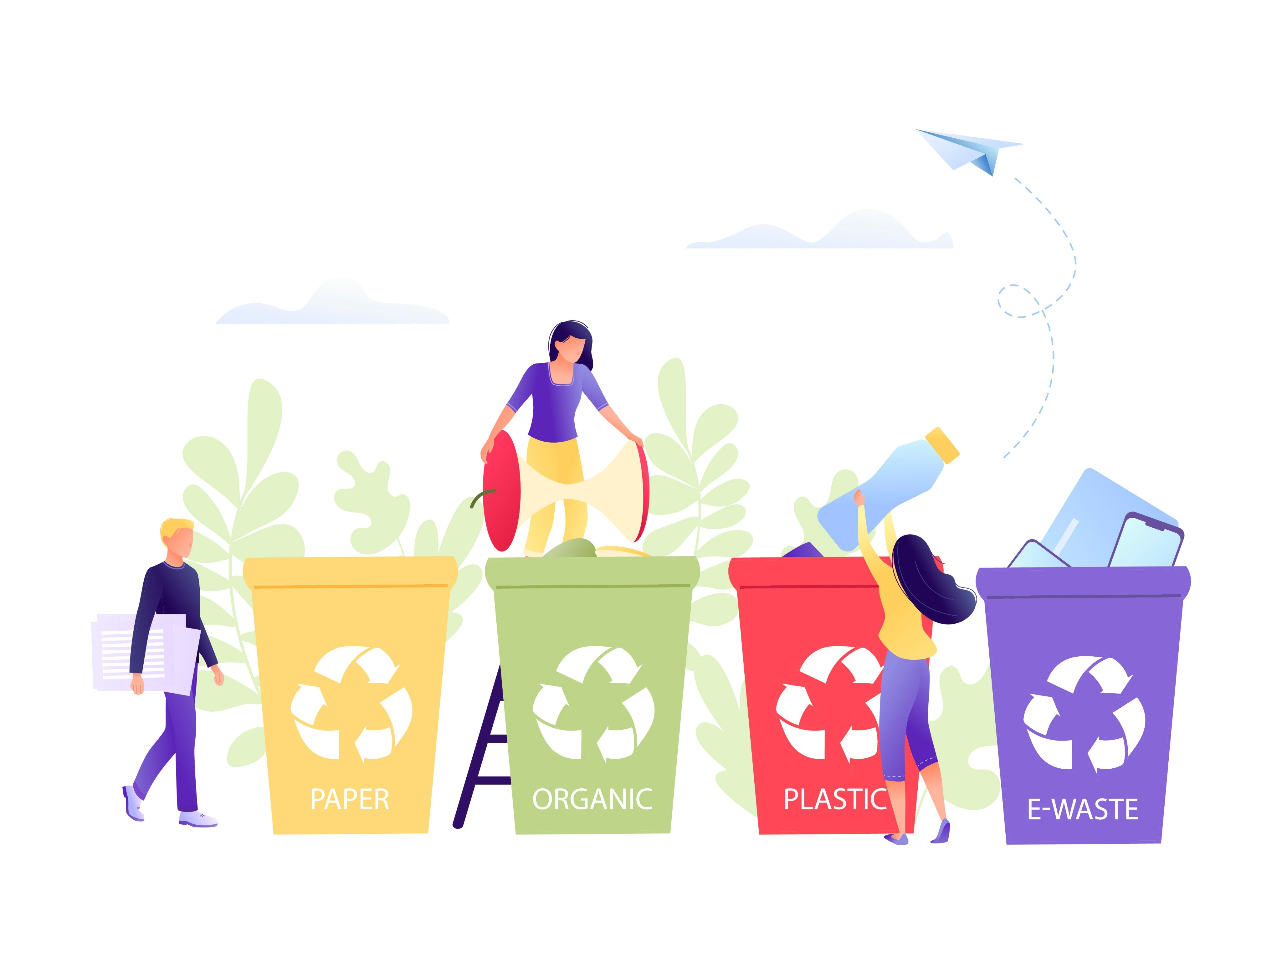

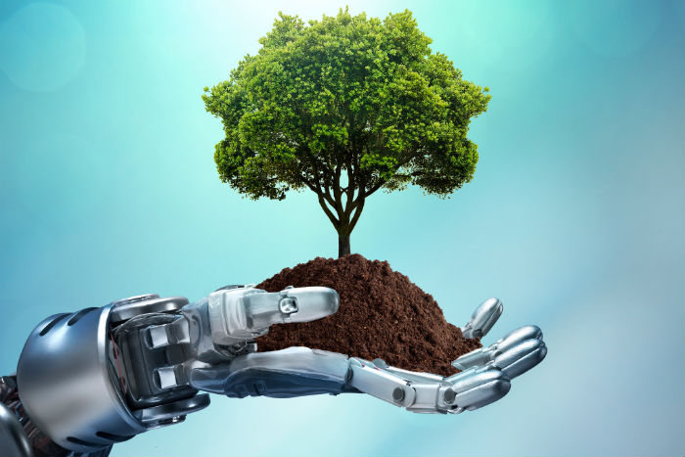
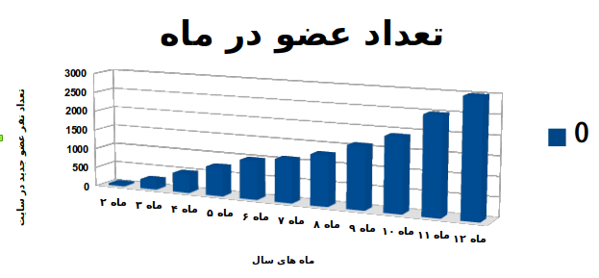
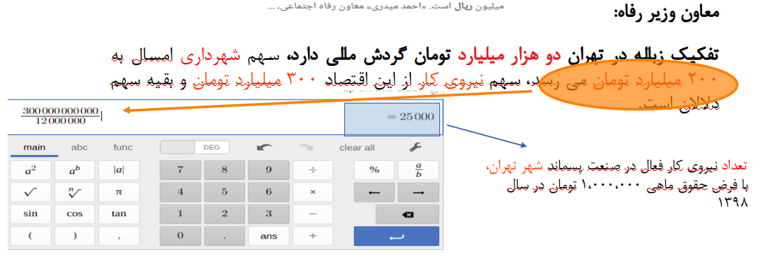
Customers
Buyers and sellers of waste materials
Green Charities and organizations involved in waste recycling and Environmental Activities (provincial, etc.)
New technology enthusiasts
and preserving the environment (intelligence
Artificial and…)

Slide 8
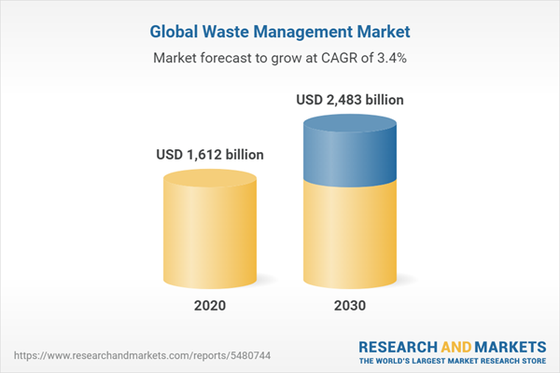
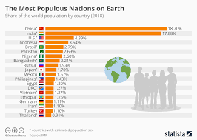
Market
Size of Iternationa Waste market for the first year (Billion $)
TAM | SAM | SOM
1600X0.1= 16.0 B$ | 16x0.3=4.8 B$ | 0.01 B$
By Assumption of having %30 share on the %60–%80 of total Waste Management System (WMS) costs, for the cost of waste Logistics.
By Assumption of working in the USA,Canada, India for first year we have %21.96 (%4.18+%17.3+%0.48) of Earth Population and available market for first year would be around %0.01 which is 10 M$.
The global waste management market size was valued at $1,612.0 billion in 2020 (link)

Slide 9
Market
Customers
Size of Iran's total recycling market for the first year (million Tomans)
TAM | Sam | SOM
2000X0 . 1 = 200 | 160 | 48
Buyers and sellers of waste materials
Green Charities and organizations involved in waste recycling and Environmental Activities (provincial, etc.)
New technology enthusiasts
and preserving the environment (intelligence
Artificial and…)
Monthly membership fee 10,000 Tomans for about 0.6 25,000 x active labor force in waste collection in Tehran
Monthly membership fee 10,000 Toman for about 3000 members at the end of 13 months
Annual turnover of waste separation in Tehran Two thousand billion Toman ( source of ISNA website )

Slide 10
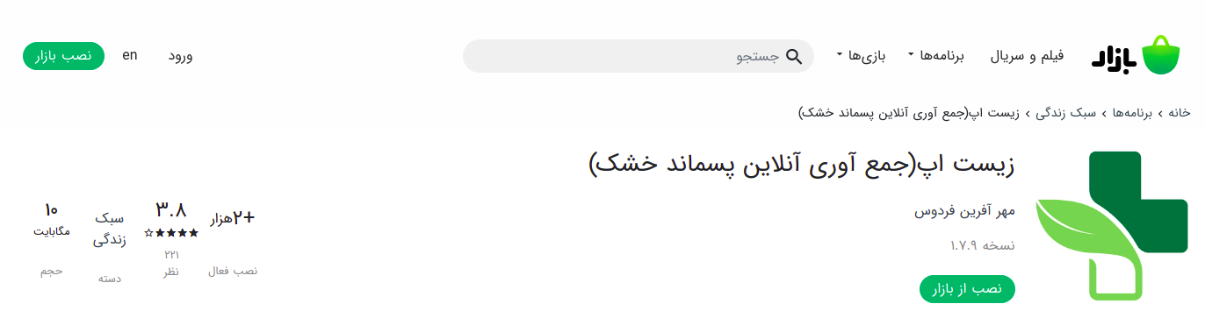
Marketing plan
Internet
Telegram
buyers ( recycled and ... )
And ...
The number of installs of a recycling app instance

Slide 11
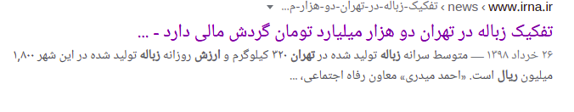
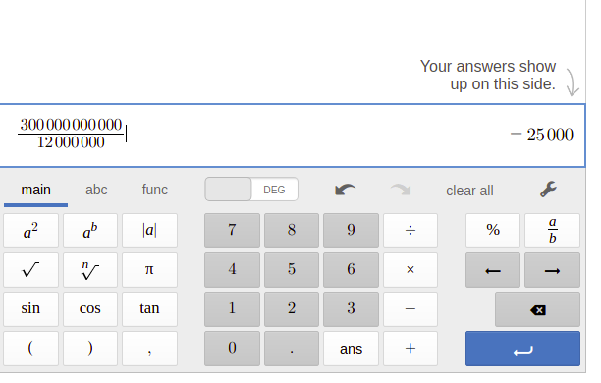
Garbage turnover in Iran
Deputy Minister of Welfare:
Garbage separation in Tehran has a financial turnover of two thousand billion tomans, the share of the municipality this year is 200 billion tomans , the share of the workforce in this economy 300 billion tomans and the rest is the share of dealers.
number of active workers in the waste industry of Tehran, assuming a monthly salary of 1,000,000 Tomans in 2018
from the recycling site, dry waste in 2014 in Tehran , as a result of recycling these materials in addition to 57,000,000 rials,
Reduction in disposal costs, about 1,090,000,000 Rials
The net income is obtained from the dry waste recycling site.

Slide 12
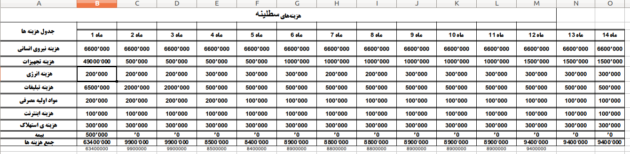
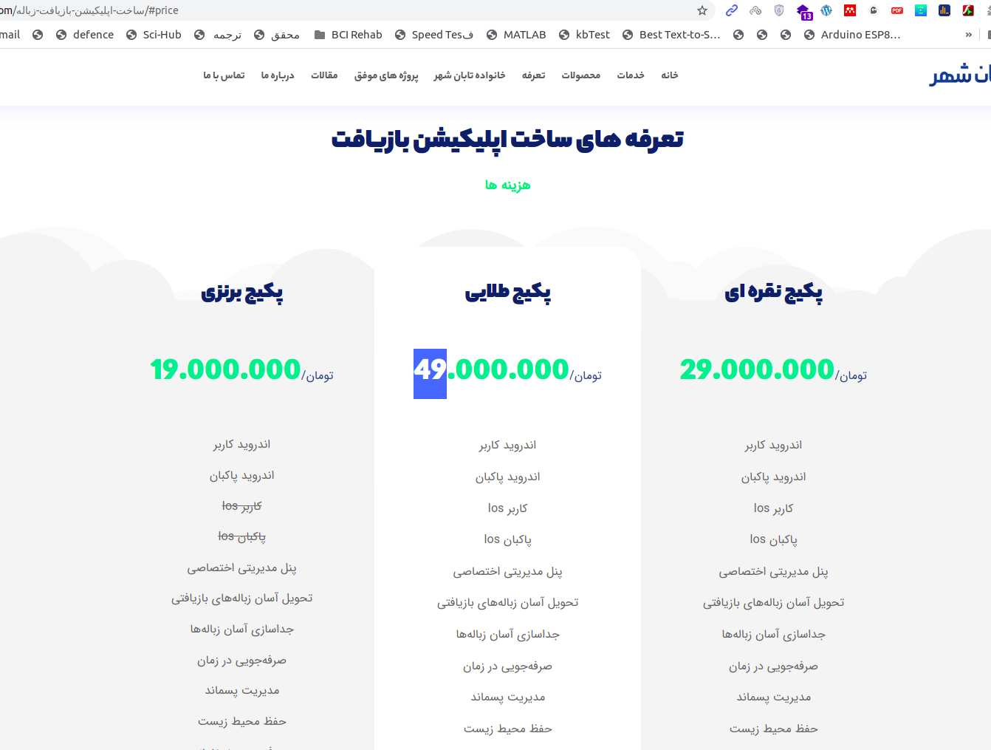
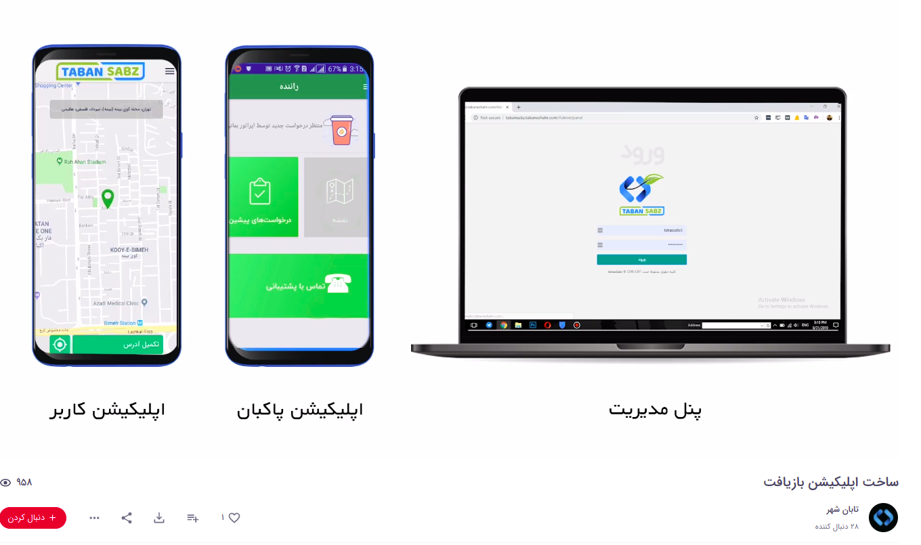
Estimated project costs for 14 months
Site link And
Aparat video

Slide 13
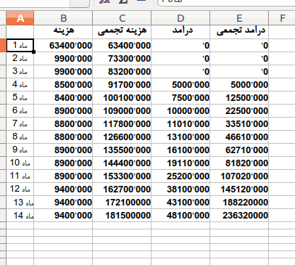
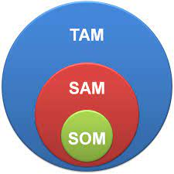
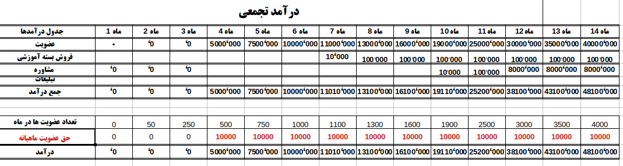
Head to head curve
Size of Iran's total recycling market for the first year (million Tomans)
TAM | Sam | SOM
2000 * 0 . 1 = 2000 | 160 | 48
The main source of income
Monthly membership fee
10,000 Toman

Slide 14
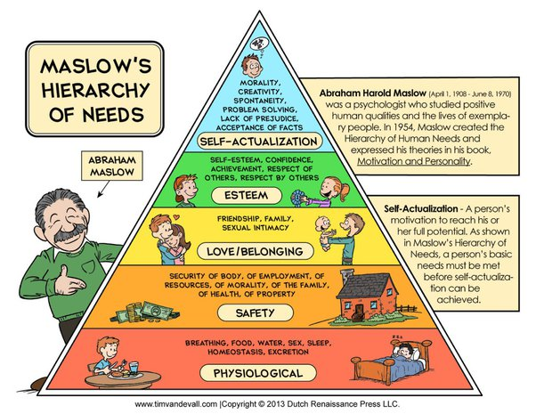
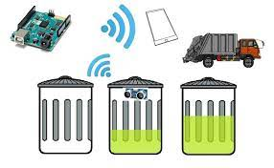

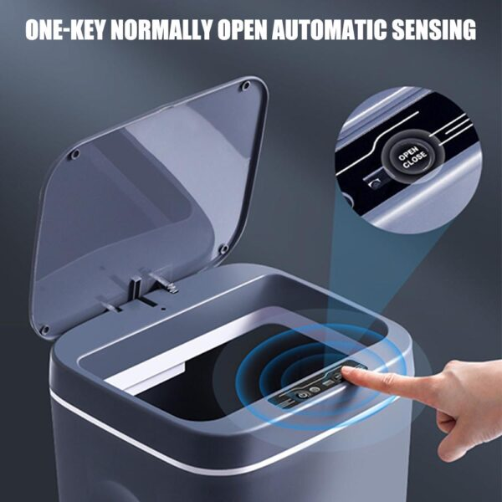
Road Map
Row | Description of the activity | Total Time ( Month )
1 | Buying or Building an MVP UBER model Application For Trash | 3
2 | Advertising and obtaining licenses from related organizations | 3
3 | Create New Technologies for Encouraging people to do Recycling (Smart Trash Bin end ETC) | 4

Slide 15
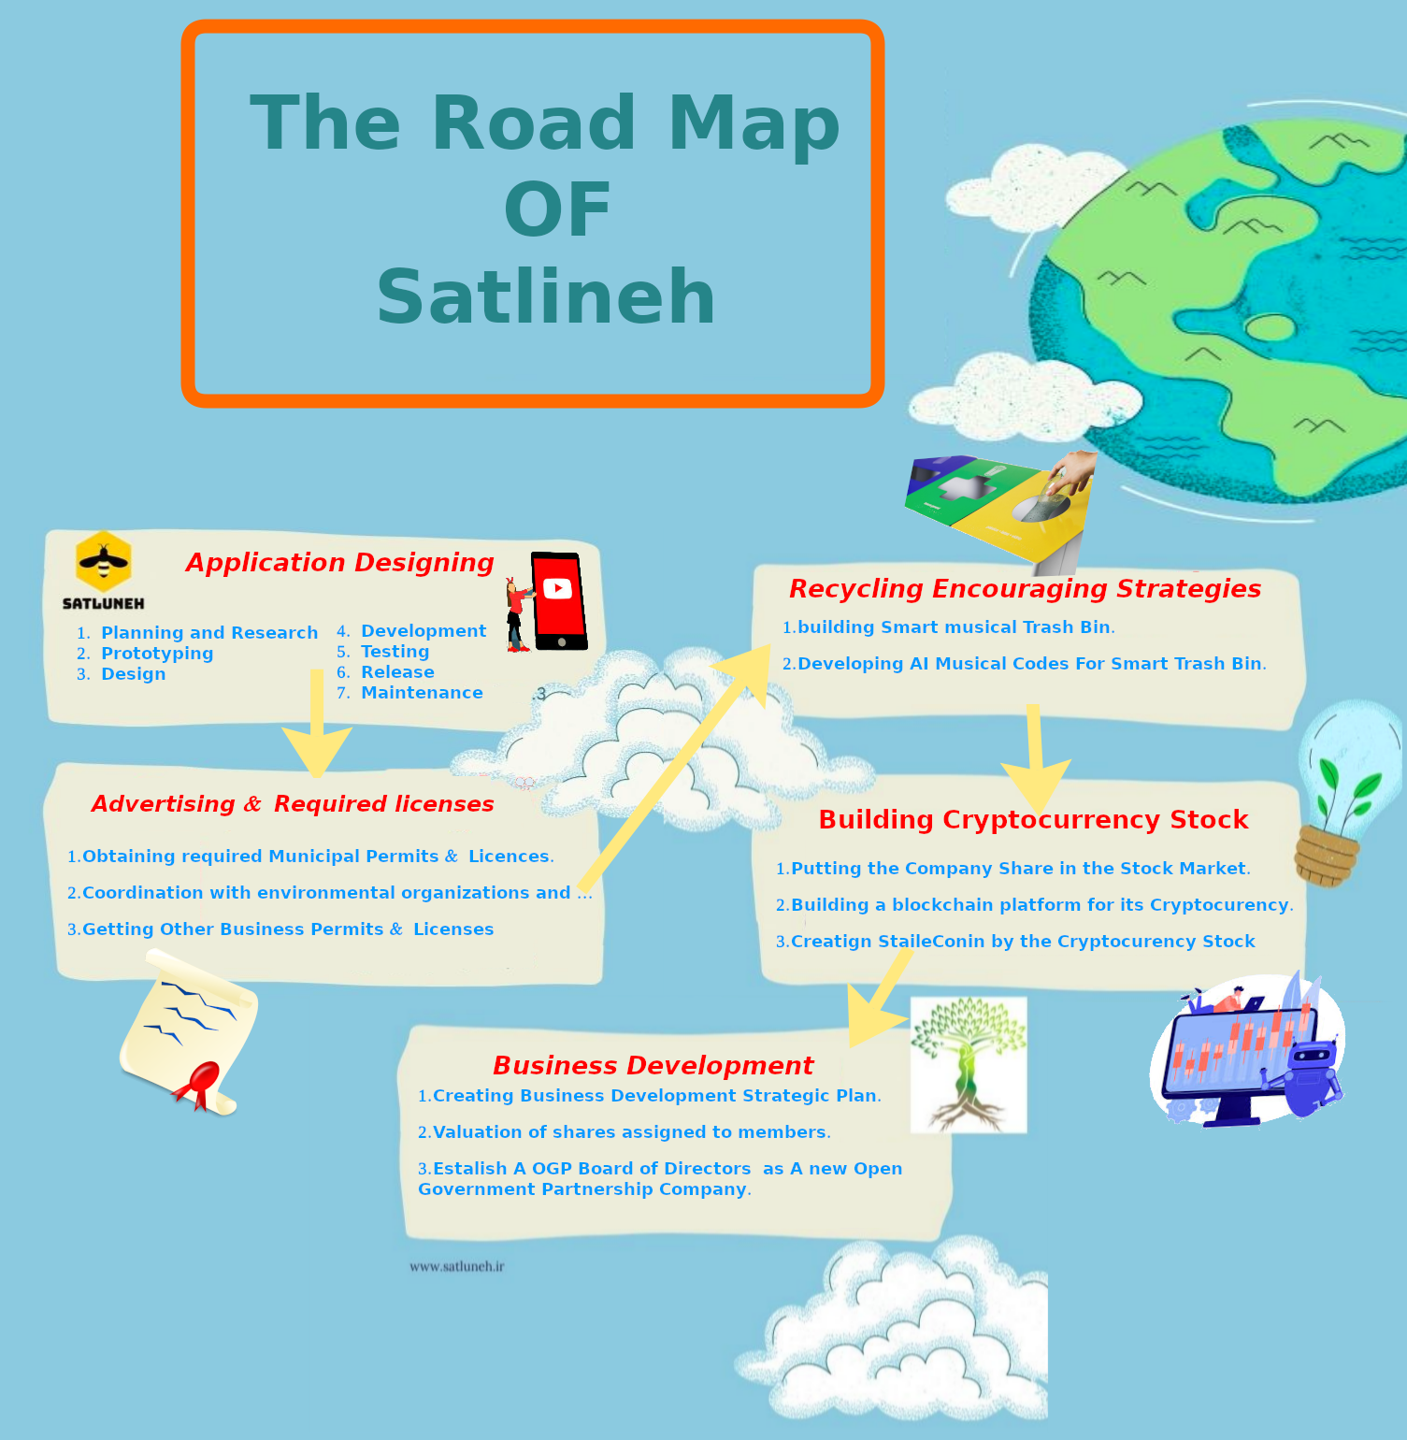
Road map

Slide 16
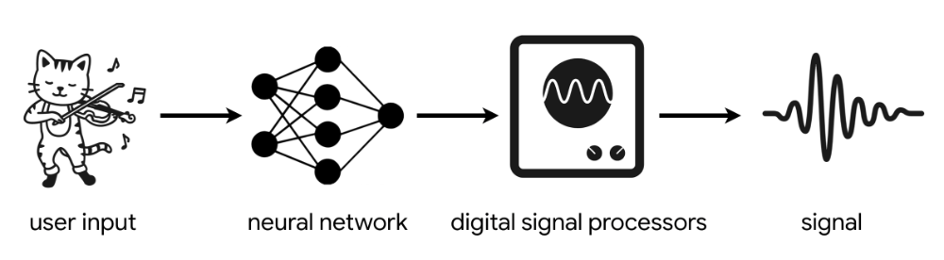
Preparing parts of the site such as:
Creating a prototype for the advertisement section of the site ( Satlineh.ir)
Collection of application and site codes on GitHub page
Making a smart trash can prototype
- Testing artificial intelligence codes in the fields of:
making music
Garbage detection from the image
Project progress

Slide 17



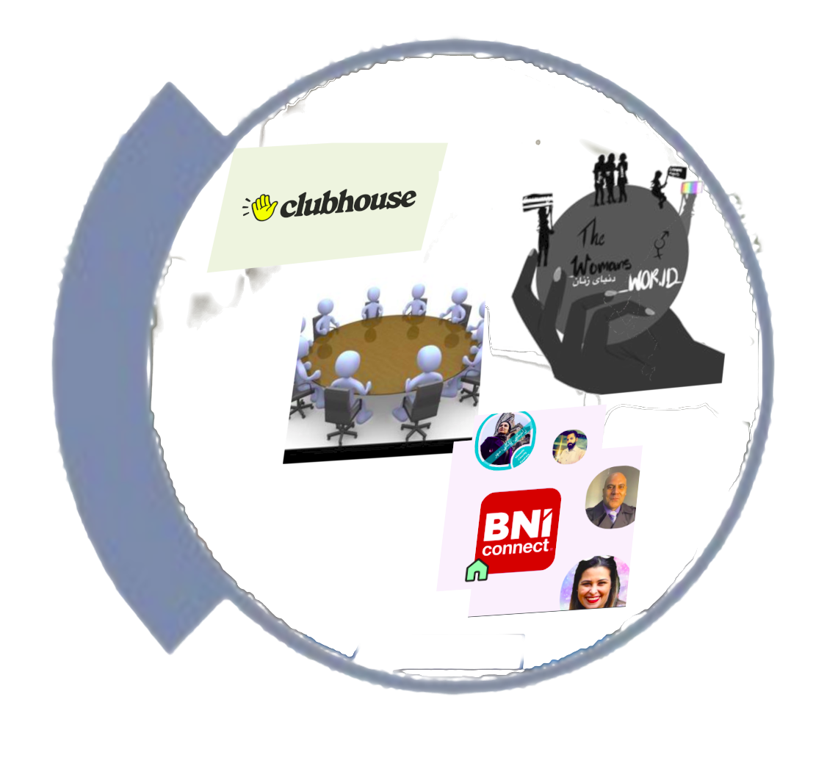


Team
Hakim University and Sabzevar Cooperative Department
Some of ClubHouse Friends
Fatima Torabi
Sohail Sabzevari
World of women's, Communication Forum and Some Other Clubhouse rooms And Friends
Accounting student and the founder of Satlina
A senior student of medical engineering and an expert in the development of Satlineh

